Slide 1

Internet Of Things
Internet Of Things
Introduction
Paul Schragger
Villanova University
Fall 2022

Slide 2
Historical Background
1990: Internet Toaster - first IoT device, John Romkey .(Hardwired/TcpIP/SNMP )
1991: Mark Weiser Coined the term: Ubiquitous Computing
“The most profound technologies are those that disappear. They weave themselves into the fabric of everyday life until they are indistinguishable from it”.
1999 – Kevin Ashton coined the term IOT as the executive director of the MIT Auto-ID Center
The initial vision was that RFID technologies would be the key to integrating sensors to the Internet
2000: LG announces it's first Internet refrigerator plans
2008-2009: The Internet of Things was "Born"
more “things or objects” were connected to the Internet than people,
( Cisco Internet Business Solutions Group (IBSG)
2011 – IoT-GSI Global Standards :
unified approach for development of technical standards enabling the Internet of Things on a global scale
http://www.postscapes.com/internet-of-things-history/
https://en.wikipedia.org/wiki/Kevin_Ashton

Slide 3
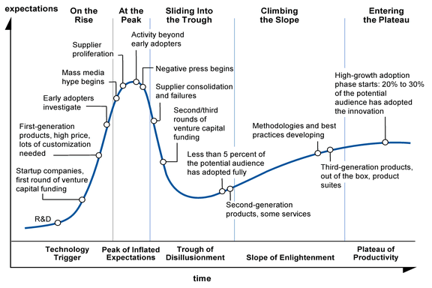
Entrepreneurial Perception of IOT
http://www.gartner.com/technology/research/hype-cycles/index.jsp

Slide 4
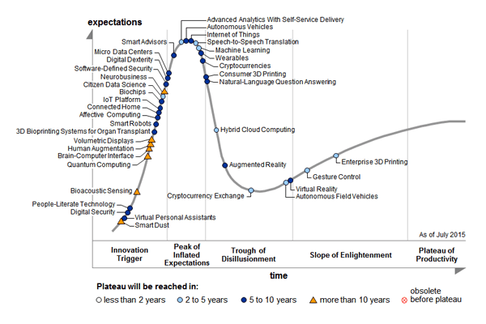
Gartner Hype Cycle July 2015

Slide 5
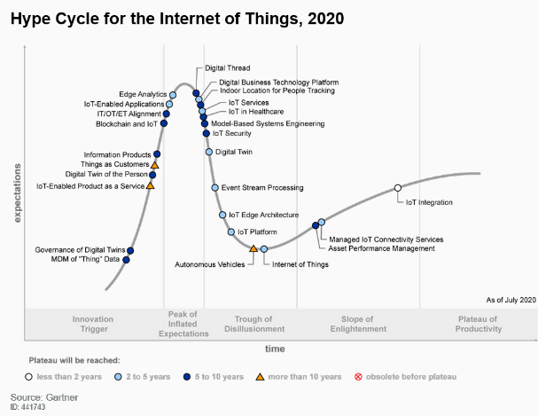
2021-hype-cycle-for-emerging-technologies

Slide 6
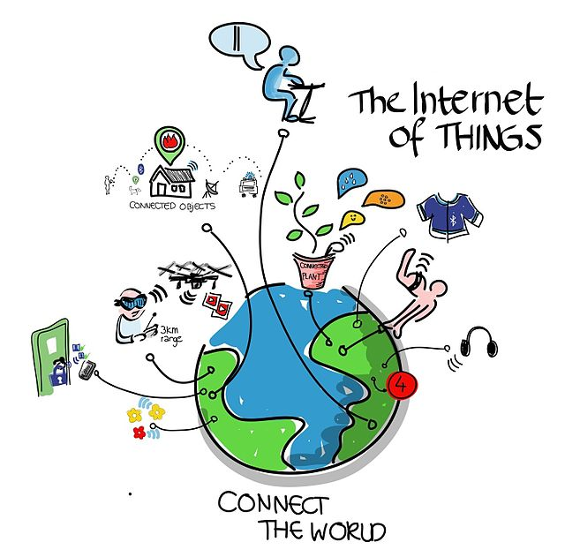
One definition for IOT
The Internet of things is the internetworking of
physical devices, vehicles , buildings, and other
items-embedded with electronics, software,
sensors, actuators, and network connectivity that
enable these objects to collect and exchange data. -
Text and Image Source: https://en.wikipedia.org/wiki/Internet_of_things
IoT has evolved from the convergence of wireless technologies, micro-electromechanical systems and
the Internet.

Slide 7
What is a thing?
A heart monitor implanted in a person.
A biochip transponder inserted in animalr,
Automobile built-in sensors that alert the driver when tire pressure is low --
Any other natural or man-made object that can be
assigned an IP address and
provided with the ability to transfer or receive data over a network.
The Internet of Things has been most closely associated with machine-to-machine (M2M) communication:
Manufacturing
Electrical power generation and distribution
Products built with M2M communication capabilities are often referred to as being smart.

Slide 8
Things in IoT
Devices that have
Unique identities
One or more functions:
Collect data (sensing)
Control other devices
Monitor other devices activities
Transform Data
Store Data
Provide access to data

Slide 9
What makes a thing “Smart”?

Slide 10
Preliminary Discussion
Data – Raw unprocessed data from IOT devices
Information – inferred from data by filtering, processing, categorizing, condensing, and contextualizing
Knowledge – inferred from information by organizing, and structuring, and then put into action to achieve specific objectives

Slide 11
Sample Application Domains of IOT
Home
Cities
Environment
Energy
Retail
Logistics
Agriculture
Industry
Health & Lifestyle

Slide 12
Welcome to the current state of IOT Front
Reference Architectures
IOT platforms
IOT Security
Edgecomputing

Slide 13
Simple Five Layer IOT Architecture
Business | BI layer for decision makers
Application | Human interface
Perception | Transformational and
| alerting functions
Transport | Network interconnect
| technology
Perception | Physical Sensor devices
https://www.celona.io/network-architecture/iot-architecture

Slide 14
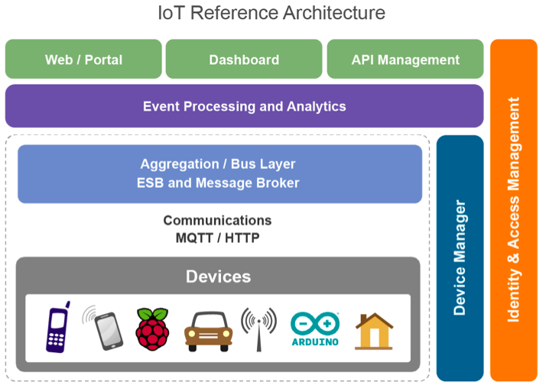
IOT Architecture
http://wso2.com/wso2_resources/a-reference-architecture-for-the-internet-of-things.pdf
f

Slide 15
IOT ARCH LAYERS
Client/external communications - Web/Portal, Dashboard, APIs
Event processing and analytics (including data storage)
Aggregation/bus layer – ESB and message broker
Relevant transports - MQTT/HTTP/XMPP/CoAP/AMQP, etc.
Devices
The cross-cutting layers are
Cc1 Device manager
Cc2 Identity and access management

Slide 16
Device Layer
IOT DEVICES must have some communications that either indirectly or directly attaches to the
Internet.
Arduino with Arduino Ethernet connection
Arduino Yun with a Wi-Fi connection
Raspberry Pi connected via Ethernet or Wi-Fi
Intel Galileo connected via Ethernet or Wi-Fi Examples of indirectly connected device include
ZigBee devices connected via a ZigBee gateway
Bluetooth or Bluetooth Low Energy devices connecting via a mobile phone
Devices communicating via low power radios to a Raspberry Pi
A unique identifier (UUID) burnt into the device (typically part of the System-on-Chip, or provided by a
secondary chip)
A UUID provided by the radio subsystem (e.g. Bluetooth identifier, Wi-Fi MAC address)
An OAuth2 Refresh/Bearer Token (this may be in addition to one of the above)
An identifier stored in nonvolatile memory such as EEPROM

Slide 17
The Communications Layer
To be part of IOT each device must have
Communications capability
Unique identifier and use IP as fundamental networking for its transport layers

Slide 18
The Aggregation/Bus Layer
1. The ability to support an HTTP server and/or an MQTT broker to talk to the devices;
2. The ability to aggregate and combine communications from different devices and to route communications
to a specific device (possibly via a gateway)
3. The ability to bridge and transform between different protocols, e.g. to offer HTTPbased APIs that are mediated into an MQTT message going to the device.
The bus layer may also provide some simple correlation and mapping from different correlation models (e.g. mapping a device ID intoan owner’s ID or vice-versa).
This layer must perform two key security roles
Authentication
Policy enforcer

Slide 19
Client/External Communications Layer
External access is required for control and monitoring
Could be provided by front-end apps or API for external apps

Slide 20
Device Management
A server-side system (the device manager)
-communicates with devices via various protocols and
- provides both individual and bulk control of devices.
-remotely manages software and applications deployed on the device.
-It can lock and/or wipe the device if necessary.
The device manager also needs to
maintain the list of device identities and
map these into owners.

Slide 21
Managed Devices
There are three levels of device:
non-managed,
semi-managed and
fully managed
Fully managed devices are those that run a full DM agent. A full DM agent supports:
Managing the software on the device
Enabling/disabling features of the device (e.g. camera, hardware, etc.)
Management of security controls and identifiers
Monitoring the availability of the device
Maintaining a record of the device’s location if available
Locking or wiping the device remotely if the device is compromised, etc.
Non-managed devices can communicate with the rest of the network, but have no agent involved. The device manager may still maintain information on the availability and location of the device if this is available.
Semi-managed devices are those that implement some parts of the DM (e.g. feature control, but not software management)

Slide 22
Identity and Access Management
OAuth2 token issuing and validation
Other identity services including SAML2 SSO and OpenID Connect support
Directory of users (e.g. LDAP)
Policy management for access control (policy control point)
The identity layer may of course have other requirements specific to the other identity and access management for a

Slide 23
The Event Processing and Analytics Layer
Storage of data ( database)
data analytics platform. ( cloud scalable technologies and infrastructure)
Or local real-time analysis resources

Slide 24
IoT Functional Blocks
Application
Management
Services
Security
Communication
Device

Slide 25
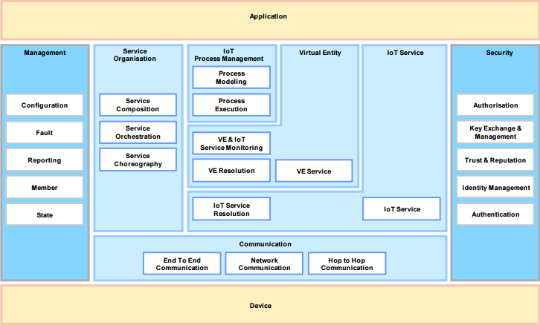
IOT Ref Arch -Functional Decomposition
http://www.iot-a.eu/public

Slide 26
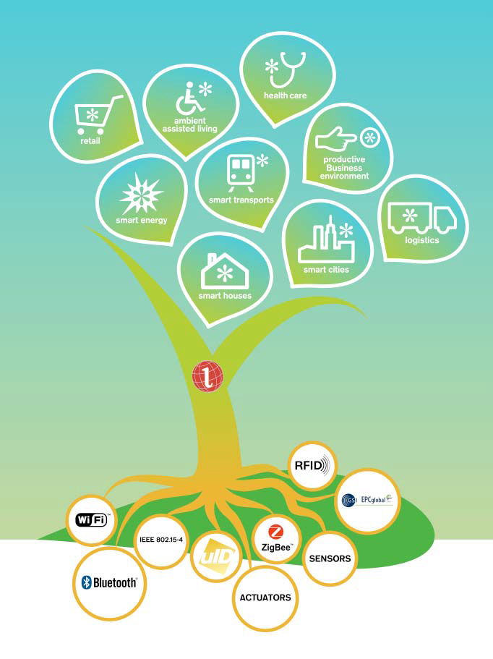
IOT-Arch Tree
IOT functions enabled on the internet using a wide range of wireless and wired networking technologies

Slide 27
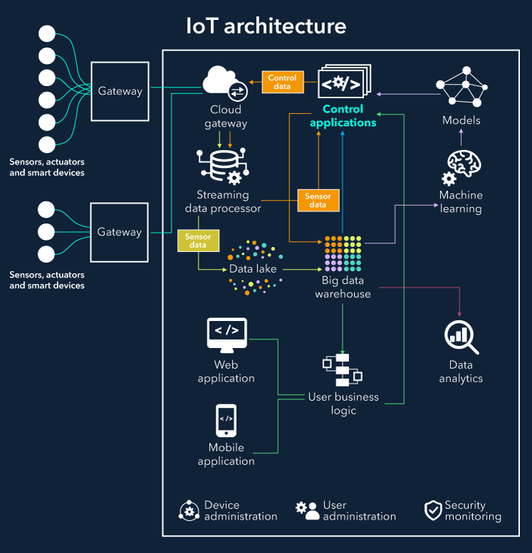
IOT ARCH
Things
Gateways
Cloud Gateway
Streaming data processing
Data Lake
Big Data Warehouse
Data Analytics
Machine Learning ( model making and running)
Control Apps
User Apps
https://www.scnsoft.com/blog/iot-architecture-in-a-nutshell-and-how-it-works

Slide 28
ISO OSI Protocol Stack
Application
Presentation
Session
Transport
Network
Data Link
Physical
Seven Layer Open Systems Integration Protocol Stack
The TCP/IP 5 layer Communication Protocol Stack is in RED
https://en.wikipedia.org/wiki/Internet_protocol_suite

Slide 29
Link Layer Protocols
Link Layer - packet encoding and signalling
802.3 Ethernet
802.11 WIFI
802.16 WiMax
802.15.4 – LR-WPAN (ZIGBEE,6LOWPAN)
2G/3G/4G/5G – Mobile Communications
Bluetooth
NB-IOT

Slide 30
Network Protocols
Network (Internet) Layer- Routing messages through interconnected devices
IPV4
IPV6
6LoWPAN (IPV6 over Low powered wireless)
Works with 802.15.4 link layer protocol

Slide 31
Transport Protocols
Transport Layer- End point to end point communications
TCP - Transmission control protocol
RFC 793
UDP – User Datagram Protocol
RFC 768

Slide 32
IOT related Application Protocols
Application Interface to lower layer protocols and to other end point applications
HTTP – Hypertext Transfer Protocol
WebSockets – Full duplex sockets
CoAP- Constrained Application Protocol
MQTT – Message Queue Telemetry Transport
XMPP – Extensible Messaging and Presence Protocol
DDS – Data Distribution Serices
AMQP – Advanced Message Queuing Protocol

Slide 33
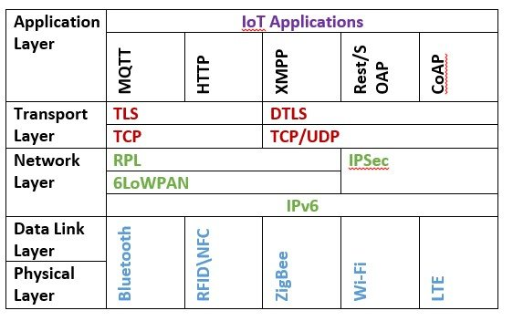
IOT Protocol Stack Examples
S. Andy, B. Rahardjo and B. Hanindhito, "Attack scenarios and security
analysis of MQTT communication protocol in IoT system," 2017 4th
International Conference on Electrical Engineering, Computer Science
and Informatics (EECSI), Yogyakarta, 2017, pp. 1-6

Slide 34
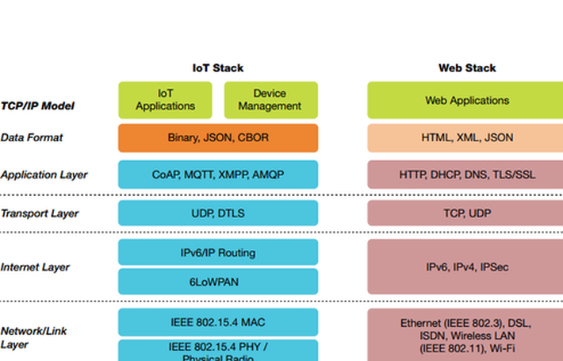
iotstack vs webstack
https://www.iotone.com/guide/emerging-open-and-standard-protocol-stack-for-iot/g494

Slide 35
Definitions & Characteristics
Dynamic & Self-adapting
Self-configuring
Interoperable Communications Protocols
Unique Identity
Integrated into Information Network

Slide 36
Generic block diagram of IOT Device
Connectivity
Processor
Audio/video
I/O Interfaces
Memory Interfaces
Graphics
Storage

Slide 37
IoT Communication Models
Request/Response
Publish-Subscribe
Push-Pull
Exclusive Pair
https://technophileholmes.hashnode.dev/internet-of-things-communication-models-and-apis

Slide 38
IoT Communication APIs
Rest-based Communication API
Websocket-based Communication API
https://technophileholmes.hashnode.dev/internet-of-things-communication-models-and-apis

Slide 39
Wireless Sensor Networks .
Distributed devices/sensors
Monitor physical/environmental conditions
Weather Monitoring
Indoor Air Quality Monitoring
Soil Moisture systems
Surveillance Systems
Smart Grids
Structural Health Systems (buildings)

Slide 40
Cloud Computing
Transformative technology
IAAS – infrastructure as a service
PAAS – Platform as a service
SAAS – Software as a service

Slide 41
Big Data Analytics
Data whose volume, velocity, or variety is so great that it is difficult to store, process, and analyze using traditional tools
Distributed processing with Map Reduce
Open source Big Data – hadoop, Spark, ...

Slide 42
Communication Protocols
Backbone to IOT
Enable network connectivity
Coupling of applications
Exchange of data

Slide 43
Embedded Systems
Computer for a specific job
Not usually a PC
Has special hardware for specfic task ( monitoring or control)
Small Size,
Low energy consumption
Fairly autonomous

Slide 44
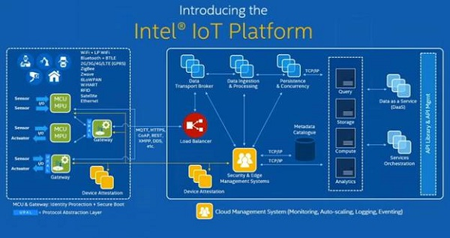
IOT Platform
Intel’s Vision of an IOT platform has basically two building blocks
1 Things and gateway
2 Cloud management and service
https://www.codeguru.com/iot/iot-development-platform-intel-iot-platform/

Slide 45
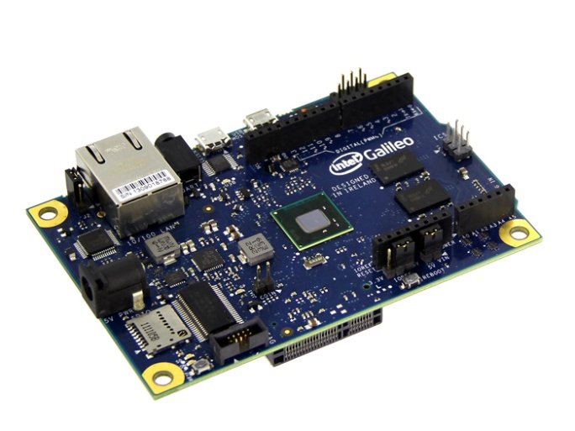
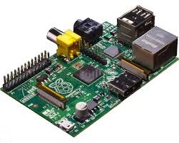
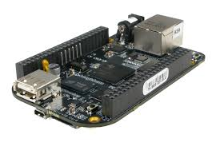
IOT Gateway
The heart of a cloud platform could use open source boards like the Raspberry Pi, Beaglebone Black, Intel Galileo etc. These are usual Linux boards that run different flavours of Linux like Raspbian on the Raspberry Pi, Angstrom on the Beaglebone etc. These boards interface with devices on the one hand and the cloud platform on the other.

Slide 46

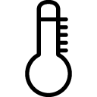
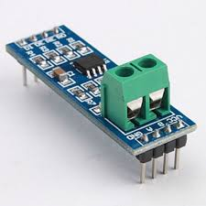
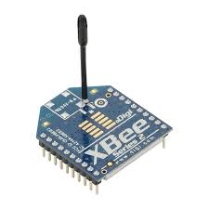
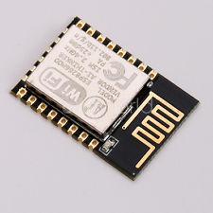
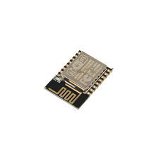
Sensor Interfaces
devices could interface with the Raspberry Pi over RS-485, and Xbee.
An RS-485 network allows a multi-dropped serial wired network allowing a host of devices to connect. The Xbee creates a wireless mesh network allowing large number of wireless devices to connect.
ESP8266 uses wifi to create talk to gateway.These are open source interfaces and allows creation of a large sensor network. We could also use the GPIO on the Raspberry Pi for physical inputs.

Slide 47
Block Layout of IOT system
App
Cloud
Observer node
Local
Observer node
REST/API
services
Analytics
Database
Cloud
Coordinator
Local
Coordinator
Controller
Gateway
Device

Slide 48
IoT Local Only Architecture
App
Single device/node
Sensing or actuation
Local datastore
Local analysis
Access via Rest
Used by an remote application
Example: Home Automation
REST/API
services
Database
Controller
Gateway
Device
Local

Slide 49
IoT cloud access architecture
App
Single device/node
Sensing or actuation
Remote/cloud datastore
Local analysis
Control via Rest
Central/cloud rest services for
Monitoring
Control
Example: Irrigation Visualization
REST/API
services
Database
Controller
Gateway
Device
cloud
Local

Slide 50
IoT Cloud Analytic Architecture
App
Single device/node
Sensing or actuation
Remote/cloud datastore
Remote/Cloud analysis
Control via Rest
Central/cloud rest services for
Monitoring
Control
Example: Package Handling
REST/API
services
Database
Controller
Gateway
Analytic
services
Device
cloud
Local

Slide 51
IOT Sensor Net Architecture
App
Observer node
Multiple devices/nodes
Sensing or actuation or observing
Remote/cloud datastore
local analysis
Control via Rest
Central/cloud rest services for
Monitoring
Control
Example: Noise Montoring
REST/API
services
Controller
Database
Controller
Controller
Gateway
Gateway
Gateway
Analytic
services
Device
Device
Device
Observer node
cloud
Local

Slide 52
IOT Big Data Architecture
App
Observer node
Multiple devices/nodes
Sensing or actuation or observing
One coordinator node
Remote/cloud datastore
Cloud analysis
Control via Rest
Central/cloud rest services for
Monitoring
Control
Big data analytics
Example: Forest Fire Detection
REST/API
services
Controller/
coordinator
Controller
Database
Controller
Gateway
Gateway
Gateway
Analytic
services
Device
Device
Device
Observer node
cloud
Local

Slide 53
IoT Big Data with Distributed Control
App
Multiple devices/nodes
Sensing or actuation or observing
Cloud Controller
Remote/cloud datastore
Cloud analysis
Control via Rest
Central/cloud rest services for
Monitoring
Control
Big data analytics
Example: weather monitoring
Observer node
REST/API
services
Database
Controller
Coordinator
Controller
Controller
Gateway
Gateway
Analytic
services
Gateway
Device
Device
Observer node
Device
cloud
Local

Slide 54
References
https://wso2.com/wso2_resources/a-reference-architecture-for-the-internet-of-things.pdf

